Slide 1
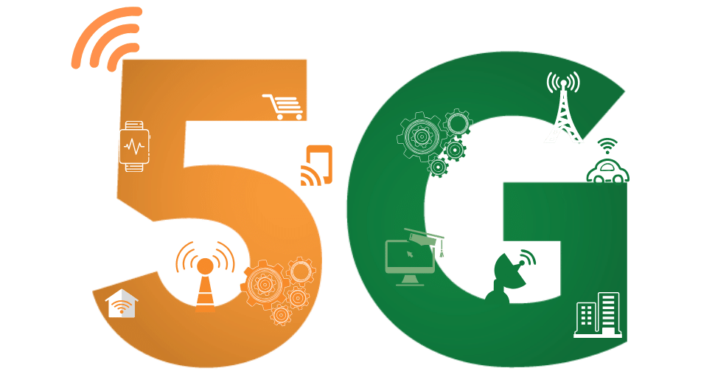


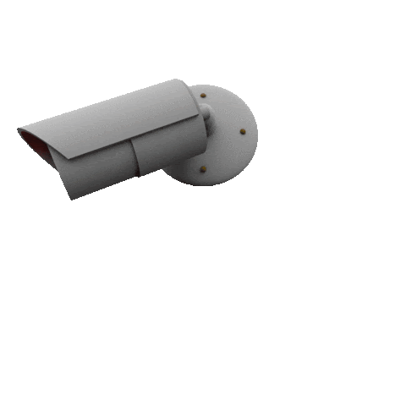
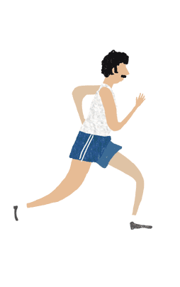
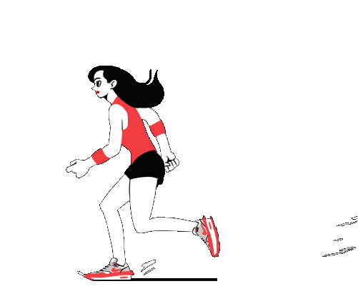
Problem Statement by :
Government of India
Use case for Upcoming 5G Technology
Let’s talk about women’s safety.
Team Name
Nokia 3310

Slide 2

Problem 1
Problem needs to be solved.
India was ranked first and named the world's most dangerous country for women in 2018. And according to stats a girl is being raped in every 20 minutes.
Problem 2
More than 90% cases about women rape, lost under the files due to society fear or lack of authority.
Problem 3
Lack of Self Defense tools and Quick Access to them using latest technologies.
Problem 4
Lack of awareness and fear of punishment among the wrong doers.

Slide 3
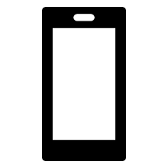








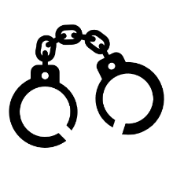


Solution and Approach
Mobile Application
A unique mobile application has been developed.
A hardware gadget with emergency features if control over mobile phone is lost.
Web portal for complete location Monitoring which will direct police and authorities to have patrolling over most affected areas.
Uniqueness of our Application
On shake emergency call and location sharing feature.
With same shake one can capture the photo of attacker and that photo will automatically be sent to guardian via WhatsApp.
Now what will happen where there is no internet? We will be sending the same signal via SMS. It means all the emergency operations are working just by a shake on a particular gesture.
Voice clips of 5-10 sec will also be streams continuously after shake.
We have One-Tap OLA Ride booking feature enables to automatically book a ride to nearest police station or home.
How we are preventing mishappening.
A women who is in danger will shake her phone or use our app to send a push notification. If our app is made a default app for every smart phone user everyone near her will be getting a pop up notification in there phone. EVEN the ATTACKER. And whoever allows that notification will be shown the shortest path to that women using google maps.
This will also give us the location of closest person near her in our database to catch the culprit.
Further we have siren feature enabled in our app.
Steps Taken towards security.
If the Wi-Fi or internet is off, our app will automatically turns it on.
If our phone is locked, just a gesture from hand is required.
No internet available? We have SMS feature enabled to send location.
Lost control over phone? We have our smart gadget to activate services.
Nothing can stop us in preventing the wrong.
Return to Home Safe and Secured.
This will surely prevent the danger and the women can be helped by many ways at a single time.
We don’t want you to think for the time of the incidence happening or after it. We are here to save the person before mishap and to make the wrongdoers believe that they cannot be saved by anyone, not even by themselves.

Slide 4
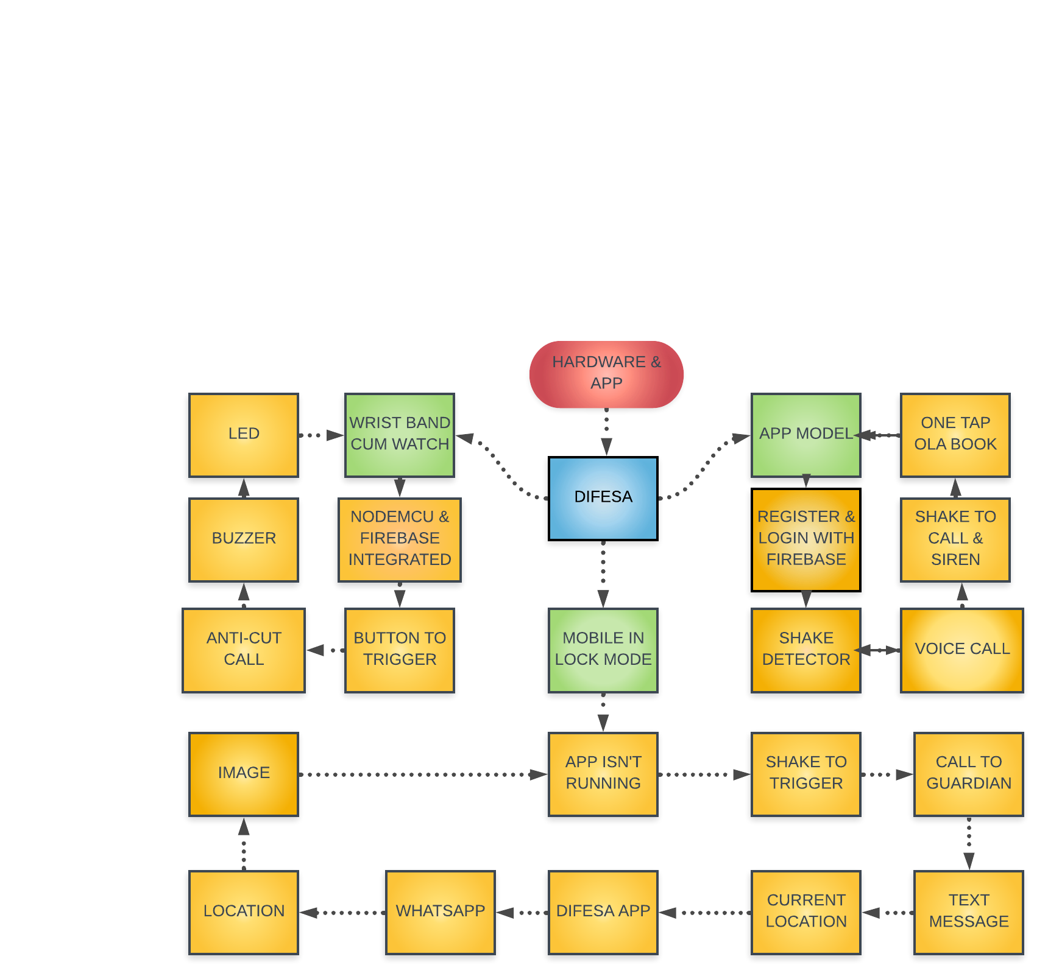

Workflow Structure

Slide 5
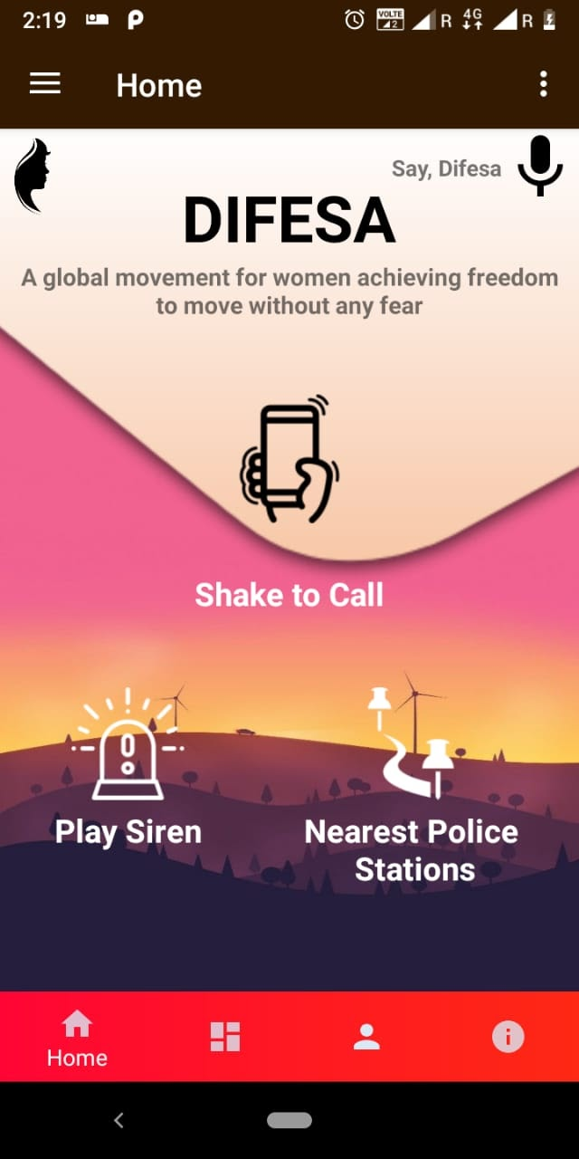
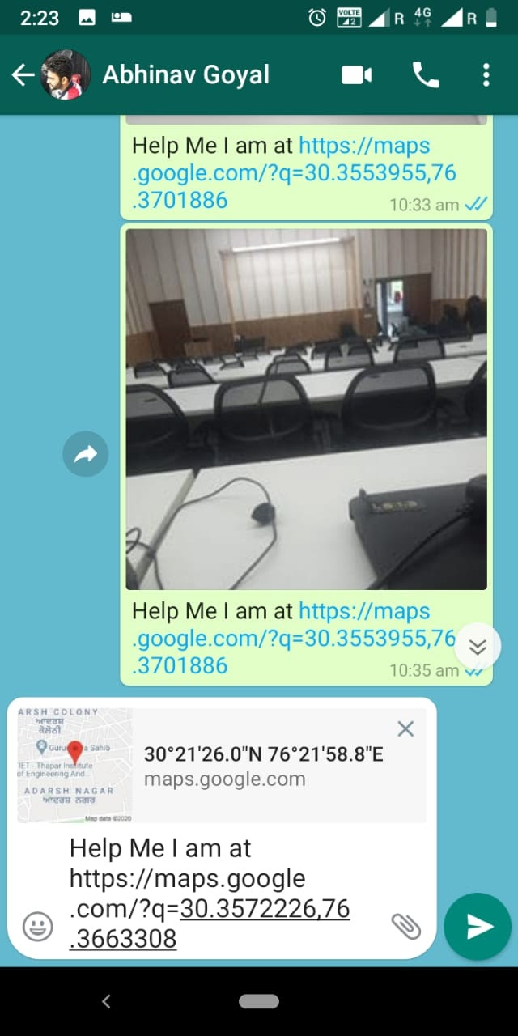
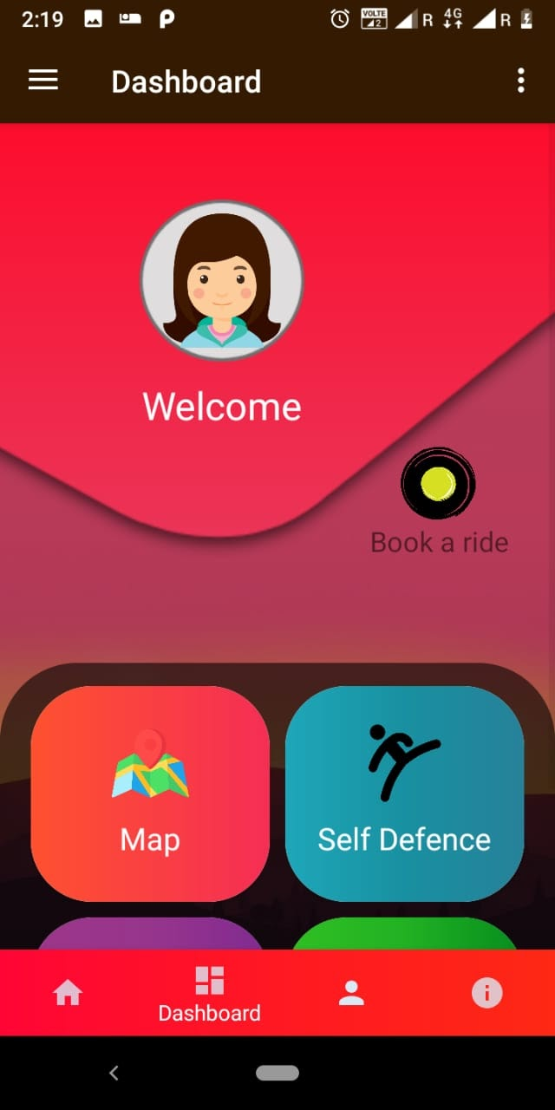
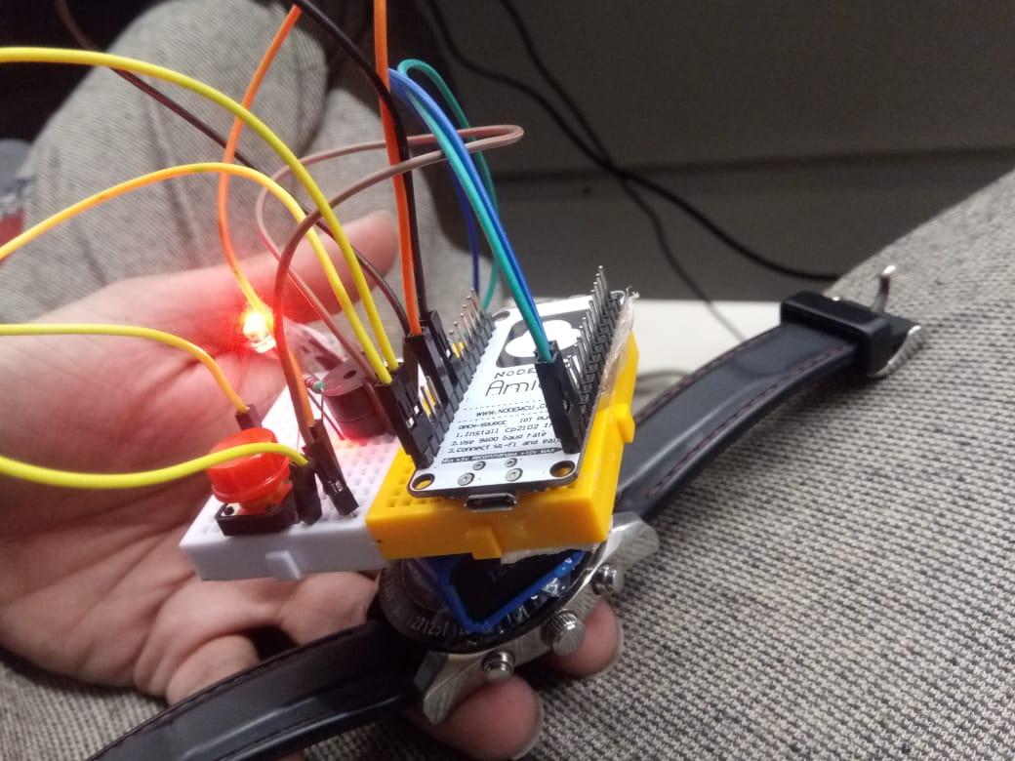
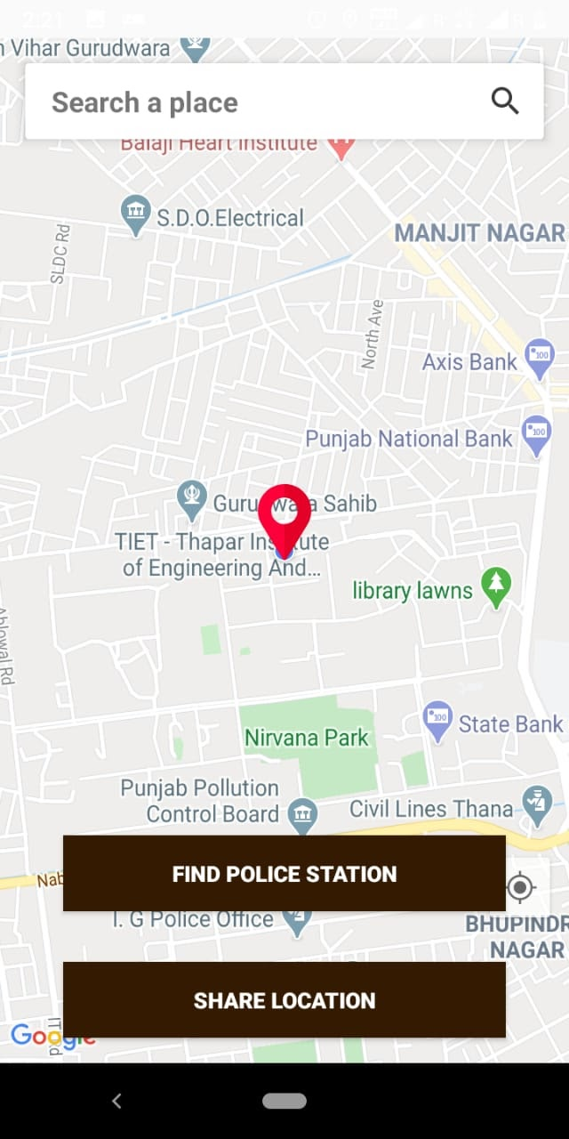
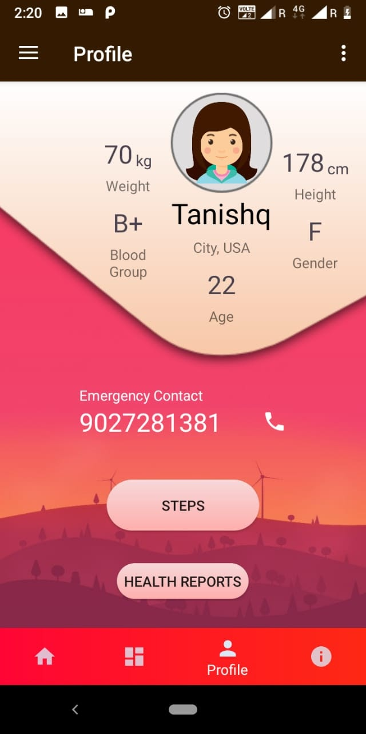
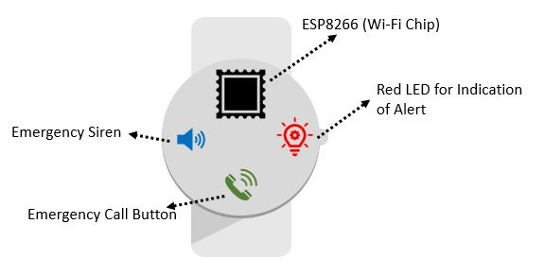
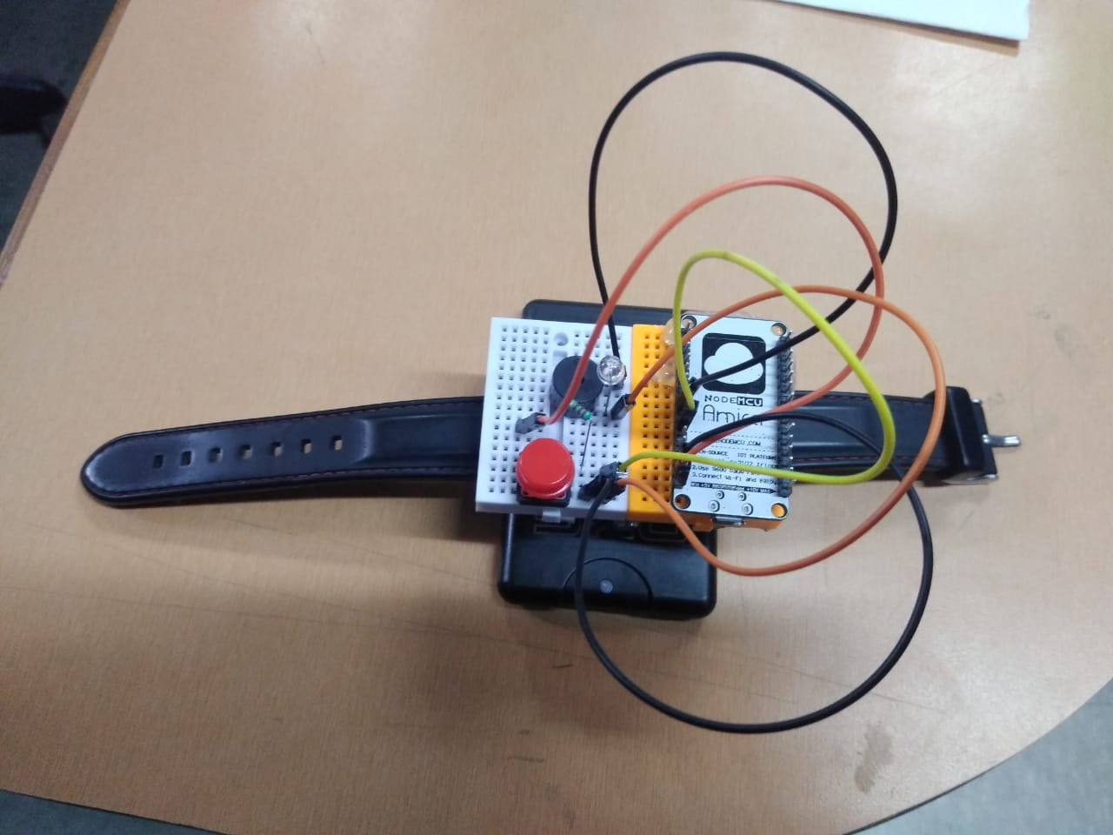
How 5G will help?
Screenshots
Faster Network and Internet speed will make our device work faster.
Access to cloud and database will be fast.
Better connectivity and reach to people.
Public Networks will be faster and police stations and hospitals can access our portal in much more efficient way.
Nearby people will get notifications earlier.
Audio and Video Clips can be Streamed easily.
Mobile Application
Smart Band
Gadget Schematic

Slide 6
Product Development Plan
Development of Web Portal Complete Web Portal will be developed for police stations to keep a check on the most affected areas and localities..
Syncing of App, Web And Hardware All three Mobile App, Web App portal and Hardware devices will be synced together to our database for complete functioning.
03
04
Prototype Development of Hardware Prototype of Smart Safety Gadget is also being made and in in proper working condition. New changes are being performed for betterment.
Production Level Hardware Design At this stage Hardware will be converted to production based design keeping aesthetics and form factor in mind to keep it efficient and usable.
02
05
Mobile Application Development Mobile Application is being developed will all the novel emergency features and many other features (such as live video clips streaming) will be added.
01
06
Testing of Complete Product Final Testing of product will be done before launch to check all the functionalities and bugs(if any).
Product Development Complete Product is ready to bring into market to prevent any mishap related to our women. Keep them safe and make our country and people proud.

Slide 7

Business Model
We will be giving free access of our Mobile Application because it’s a social cause and it needs to be monitored primarily and in the most effective way. But we can generate revenue and our maintenance cost from our hardware gadgets and Smart Android Watches and Gear Integration Application.
Smart Gadget (₹199)
Attachment (₹399)
App for Android Watches (₹999)
A Wrist Watch or a wrist band.
Wi-Fi enabled.
Buzzer.
Emergency Call Button
App Integrated
Can be provided with pepper Sprays.
Attachment for present analog and digital watches.
Wi-Fi Enabled.
Emergency Button.
App Integrated.
Advanced App for Smart Watches presently in Market.
Will be enabled with all the necessary emergency features.
One-Time Subscription.
Variant 2 is designed for most people of the society.
The product will be manufactured approximately for ₹200 to ₹250. We can generate a profit of ₹200 to ₹ 150 per piece, which can be used for development of society.
Since this variant has the potential of maximum sale, hence we will try to extract maximum profit from this product.
Variant 3 is premium product designed for people already having smart watches..
This is just an app for watches and will only cost cloud charges. So for these users, this price is quite affordable.
Variant 1 is designed for classes with low financial background. ₹200 is quite affordable.
Our product will be manufactured approximately for ₹110 and we can generate profit of about ₹80-90/piece.
Note : Concept of Psychological Pricing is being used here for better marketing.

Slide 8

Marketing Strategy
Size the Market
Time to Market
This needs to be deployed as early as possible. According to the statistics, there is one women raped in every 20 minutes. We need to curb these practices in India and let our sisters live in peace and without any fear.
We are almost ready with out App to be deployed. Just need some mentorship and finishing.
We aim to make this app a default application in every phone so that there is no way out to for wrong doers to think about touching anyone without their consent.
Total Available Market (TAM)
672 Million
Serviceable Available Market (SAM)
(Considering Ages 15-64)
432 Million
Serviceable Obtainable Market (SOM)
(Considering our product 90% Successful)
389 Million
No means, NO

Slide 9
Timing
Milestones
We need to enter as soon as possible. This cancer needs to be eradicated from the society as soon as possible.
No one has ever made this efficient technology and with this number of features to provide safety. We are not here just to catch attacker, we are here to defend the mishap and catch the thinker of performing this. We need to vanish this from our society
Hardware and Mobile App Development
Almost Completed
Testing of features with our mentors.
16th May 2020 – 15th June 2020
Gadget will be designed for production after proper feedbacks
Current Stage of Development
16th June 2020 – 15th July 2020
Final Testing of our Product
Mobile Application UI is completed
Working over video clips streaming.
Database is almost ready. (Just Need Finishing)
Web Portal UI is designed and working over backend.
Prototype of Hardware is completed.
16th July 2020 – 15th October 2020
Marketing and Distribution of our Product
15th October Onwards……
It’s Time to count on our morals and make this country the best place to live in. No Fear, No Tears.

Slide 10


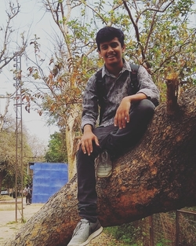
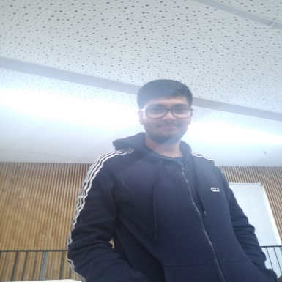
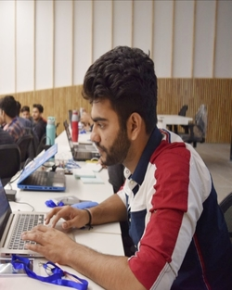











The Team
Utkrisht Agrawal
Tanishq Bhalla
Abhinav Goyal
IoT Expert (Hardware)
Cloud and Alexa
Android Developer
Firebase Expert
Full Stack Web Developer
Blockchain Geek
Technology Stack and Dependencies
Arduino
Microcontroller for Software interfacing with Hardware
WhatsApp
For Sending Notification to user
ESP8266
NodeMCU Wi-Fi Chip for Device to communicate.
Android Studio
Mobile App Development for Better User Interface
WordPress
Web User Interface Development
OLA
One Tap Ride Booking Feature
Firebase
For Application and Web Backend and Database Management
PubNub
Interfacing NodeMCU with Notification
Voiceflow
Hardware Integration of Amazon Alexa and Google Actions
Google Maps API
For detection of nearest Vaccination Centre and Child Care Hospitals.
Django
Backend Framework for our Web Portal.

